Slide 1
Why?
ST-72 examples
ST-72 sources
Desperation stage
Hope again: Rosetta Smalltalk
Rosetta Smalltalk examples
Rosetta Smalltalk sources
Fizzylogo: Rosetta Smalltalk (with some twists)
Examples of Fizzylogo

Slide 2
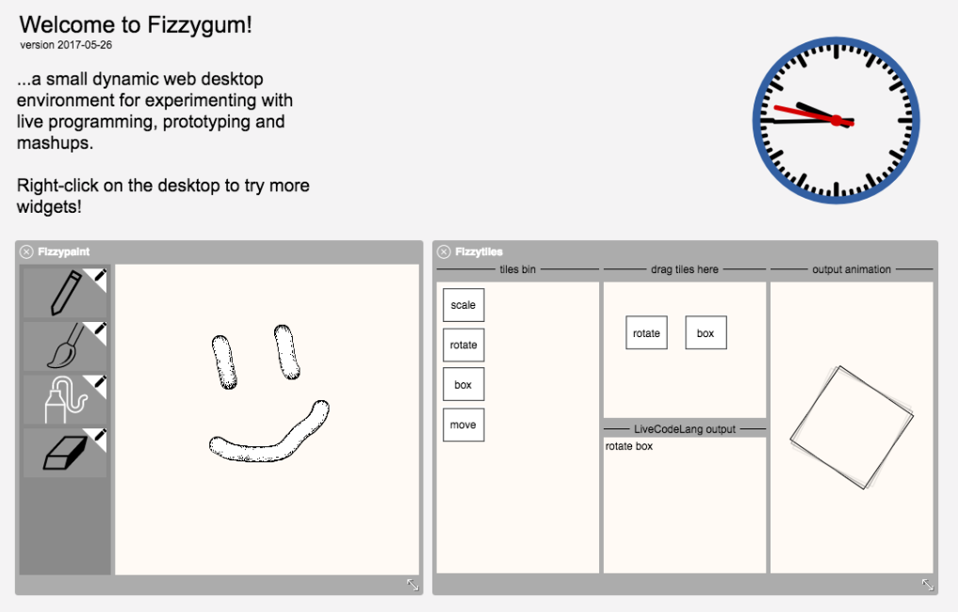
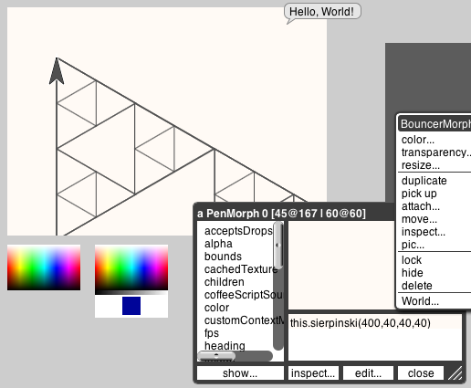
Why?

Slide 3
ST 72
flexible grammar: parsed dynamically
takes eval/apply loop of LISP, roots it in OO, bends grammar to look like LOGO
non-recursive interpreter can be used.
“To me, the most interesting thing about this exercise was how much expressive power could be obtained from a tiny amount of code” - AK
ST 76
fixed grammar
inheritance.

Slide 4
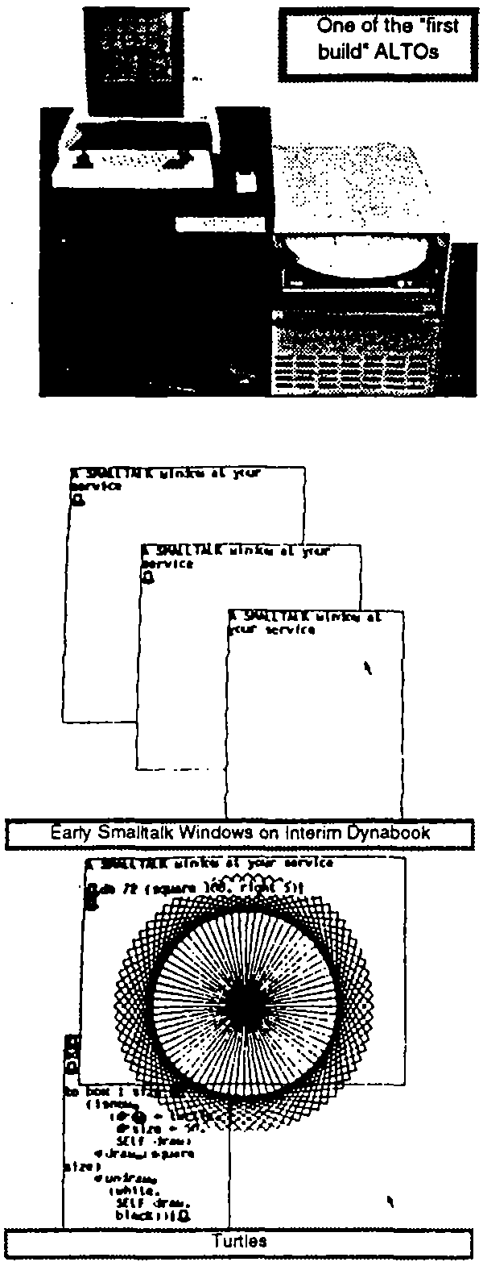
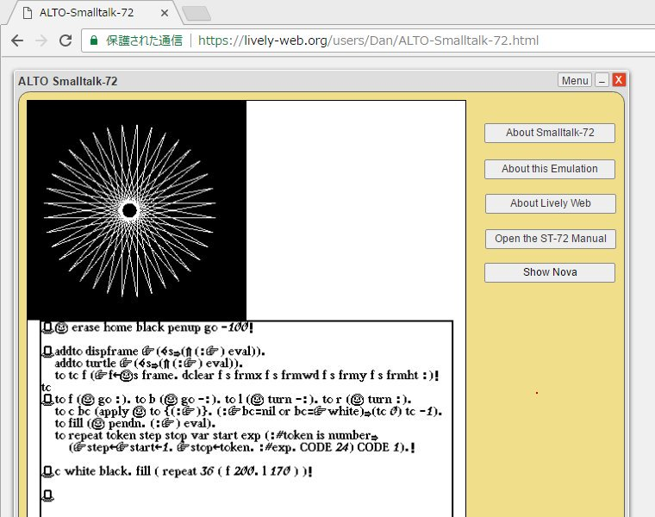

Slide 5
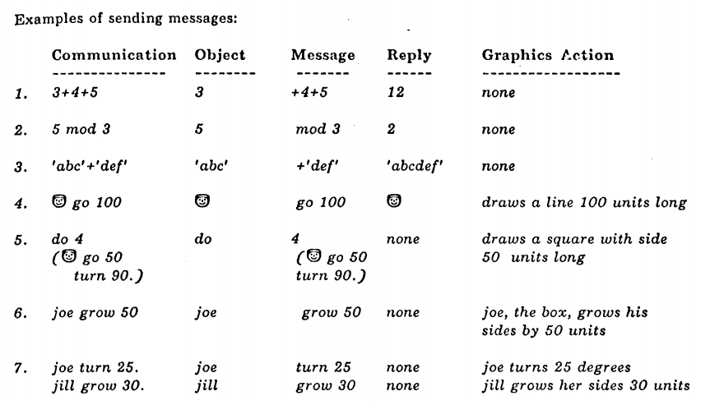

Slide 6
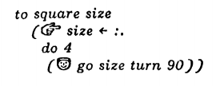


Slide 7
Evals next token
Analogous to ‘ (quote)

Slide 8
Evals next token
…lists are code blocks (homoiconic)
Analogous to ‘ (quote)

Slide 9
Evals next token
…lists are code blocks (homoiconic)
Analogous to ‘ (quote)
This is also list containing a code block, being sent an empty message, and hence it is evalled

Slide 10
“square” looks like a LOGO function, but actually creates a class.
(one could instantiate it)

Slide 11
“square” looks like a LOGO function, but actually creates a class.
(one could instantiate it)
…shorthand for:
☞ square ← class <temp vars> …
… messages and responses

Slide 12
This class only answers to one message.
“square” looks like a LOGO function, but actually creates a class.
(one could instantiate it)
…shorthand for:
☞ square ← class <temp vars> …
… messages and responses

Slide 13
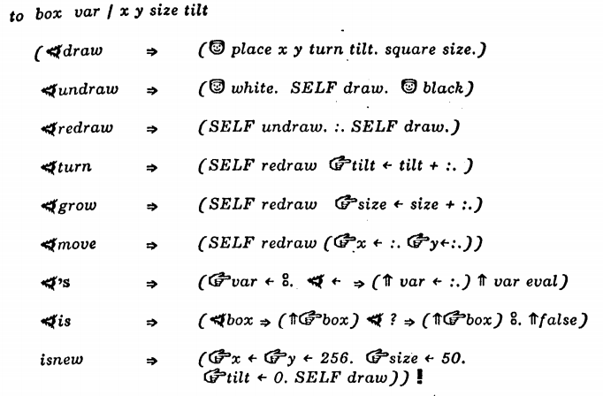
temp vars (parameters can end up here)
Instance variables of the class
All the messages that can be matched. The “eye” checks the match. Can have an arbitrarily complex match!
All these arrows are the “then” constructs

Slide 14
temp vars (parameters can end up here)
Instance variables of the class
All the messages that can be matched. The “eye” checks the match. Can have an arbitrarily complex match!
match and fallthrough: order is critical
All these arrows are the “then” constructs

Slide 15
temp vars (parameters can end up here)
Instance variables of the class
All the messages that can be matched. The “eye” checks the match. Can have an arbitrarily complex match!
This piece of code is absolutely generic. If one wants multiple messages to match, one can!
match and fallthrough: order is critical
All these arrows are the “then” constructs

Slide 16


no need for “new”: passing from “LOGO function” interpretation to full OO is completely seamless

Slide 17
(not exactly as simple as Logo though)

Slide 18
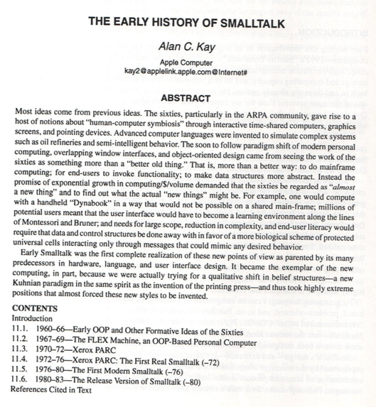
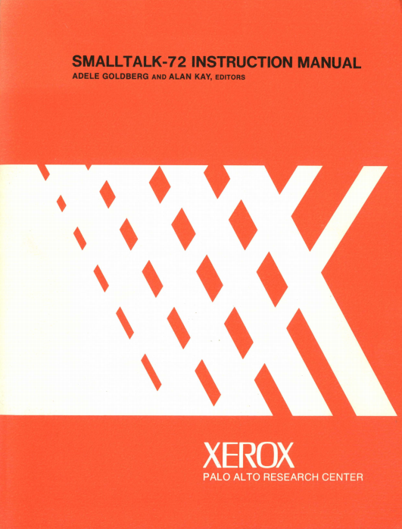

Slide 19
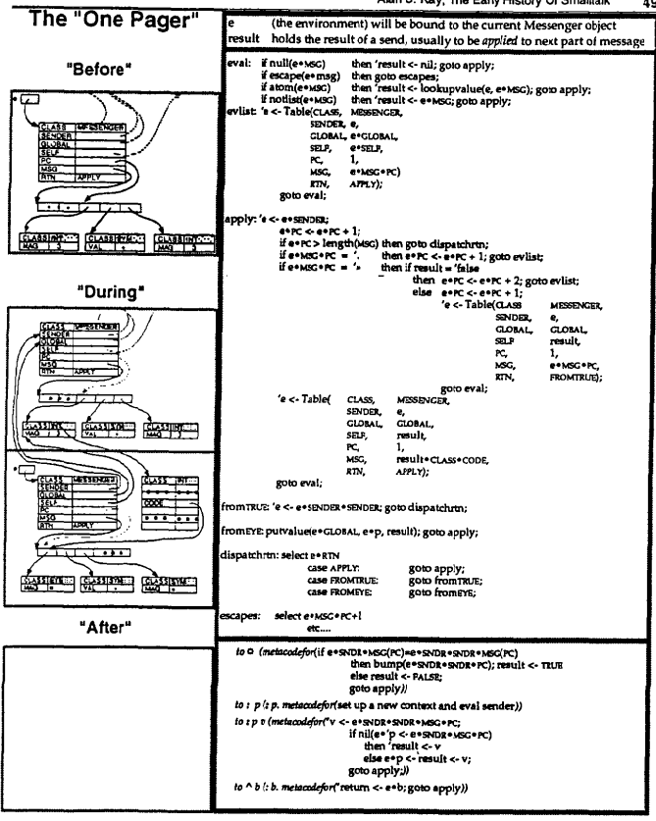

Slide 20
Eval
Apply
Object-specific behaviour specified in native code (e.g. “return”)

Slide 21
Eval
Apply
?
Object-specific behaviour specified in native code (e.g. “return”)

Slide 22
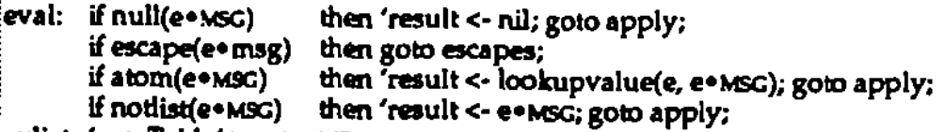
Eval
Apply
Where are the variables and the values?
?
Object-specific behaviour specified in native code (e.g. “return”)

Slide 23
Eval
Apply
Where are the variables and the values?
?
Object-specific behaviour specified in native code (e.g. “return”)

Slide 24

Eval
Apply
Where are the variables and the values?
?
?
?
?
?
Object-specific behaviour specified in native code (e.g. “return”)

Slide 25
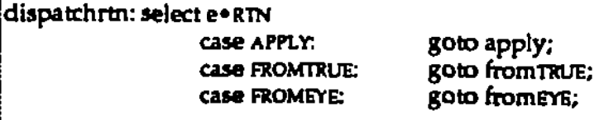
Eval
Apply
Where are the variables and the values?
?
?
?
?
?
Object-specific behaviour specified in native code (e.g. “return”)

Slide 26
Eval
Apply
Where are the variables and the values?
?
?
?
?
?
?
?
?
Object-specific behaviour specified in native code (e.g. “return”)

Slide 27
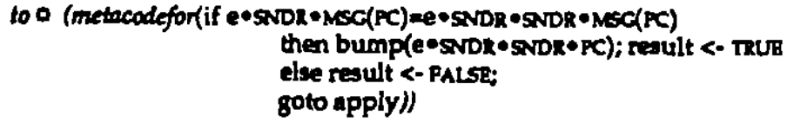
Eval
Apply
Where are the variables and the values?
?
?
?
?
?
?
?
?
Object-specific behaviour specified in native code (e.g. “return”)

Slide 28
Eval
Consecutive statements evalled in different envs?
Apply
Where are the variables and the values?
?
?
?
?
?
?
?
Object-specific behaviour specified in native code (e.g. “return”)

Slide 29
Eval
Consecutive statements evalled in different envs?
Apply
Where are the variables and the values?
?
?
?
?
?
?
?
Object-specific behaviour specified in native code (e.g. “return”)

Slide 30
Eval
Consecutive statements evalled in different envs?
Apply
Where are the variables and the values?
Assignmnent?
Quote?
?
?
How classes and objects are created?
?
?
?
?
?
Object-specific behaviour specified in native code (e.g. “return”)

Slide 31
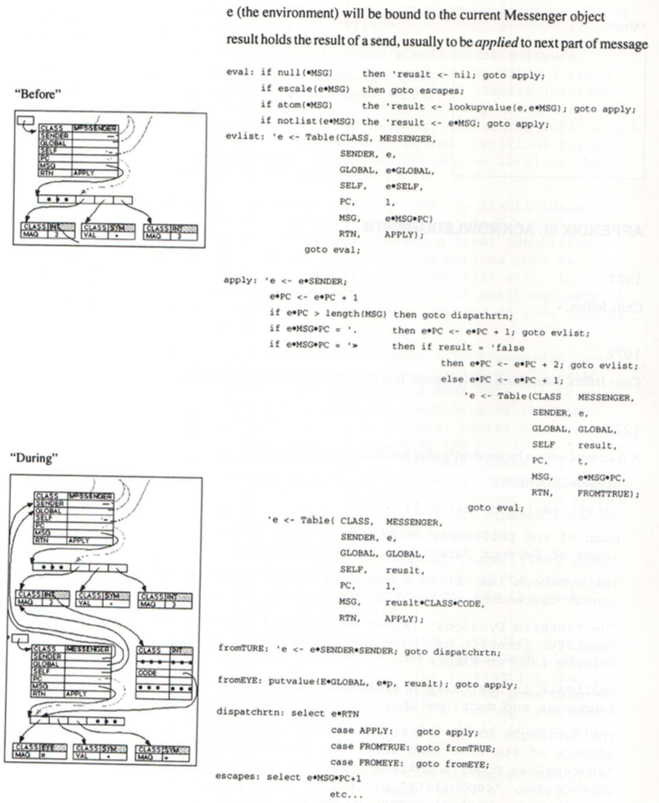

Slide 32
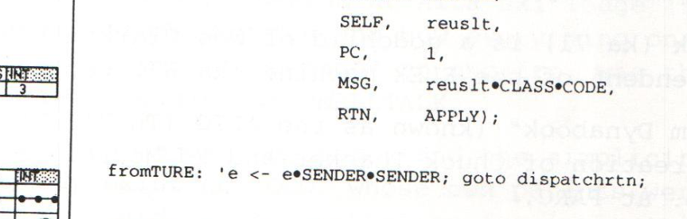
?
?
?

Slide 33
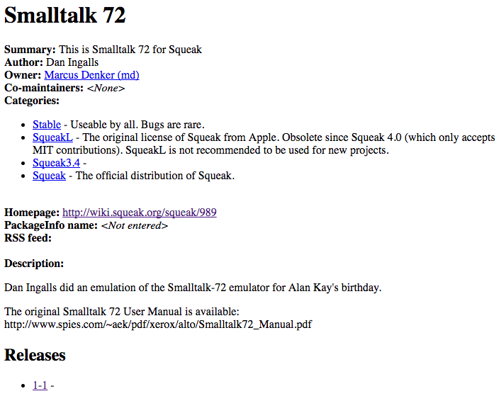
1600 LOC (probably non recursive?)
However:
1) would copy exactly an existing implementation with warts and all
"Repeats an acknowleged crock in the original ST72 intepreter: Test if an inlined vector should be evalled if it is the same as the last message token and that is not preceded by a quote(!!)”
2) could become an exercise in matching the ST runtime to JS runtime:
to: title temps: tempNames ivars: ivars cvars: cvars code: codeVector "Create a new class, or identify an existing one or Squeak equivalent”

Slide 34
“My intent was that we should eventually make the recognizers look more like BNF (there are examples of what was in mind in the history), but we never did.
However, Scott Warren (who lurks on this list) a few years later did "Rosetta Smalltalk" in which he and his friends correctly figured out where this style should go, and implemented a version in a very nice and very pretty system on an 8-bit micro”
- AK
“Scott Warren” and “his friends” are: Scott Warren, Dennis Abe, and Intel Corporation

Slide 35
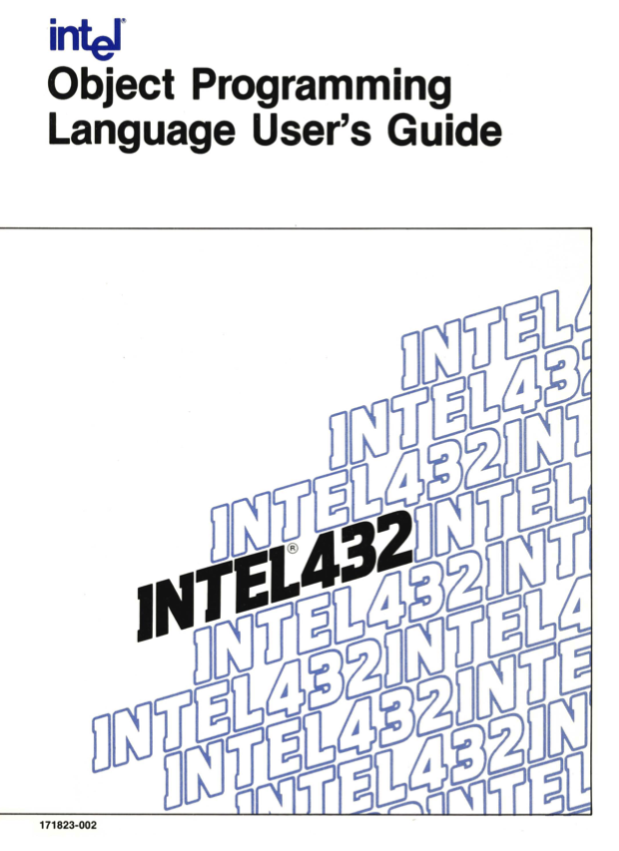
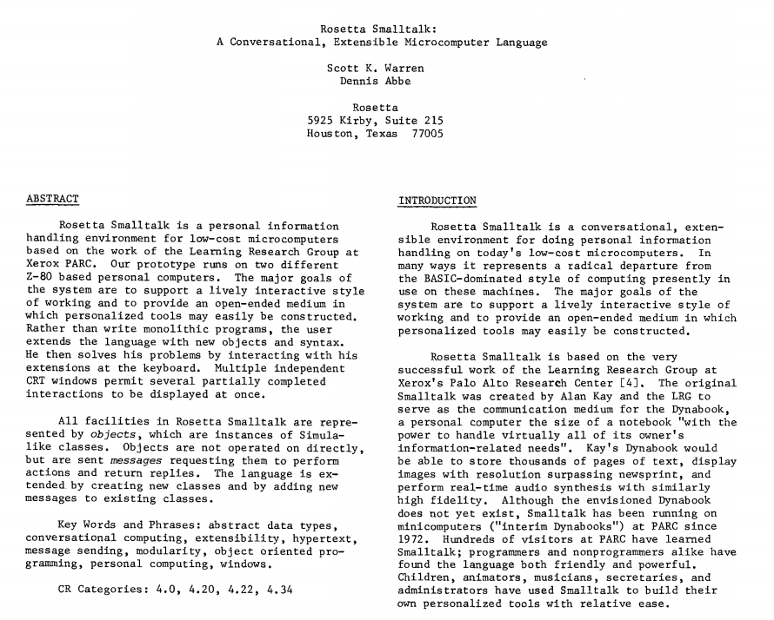
Don’t cointain pseudocode for interpreters, but contain really thourough and clear description of language, with examples

Slide 36
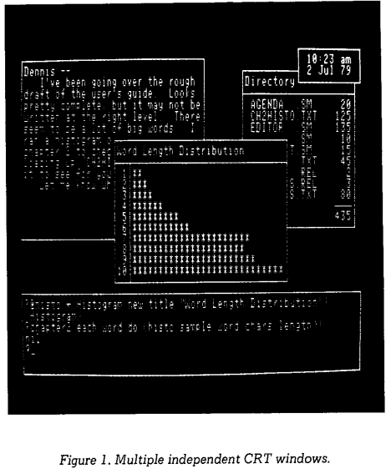
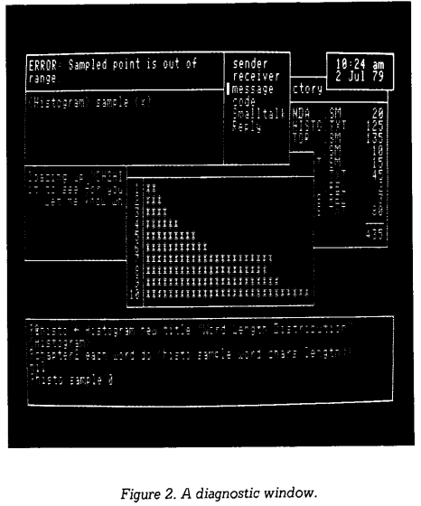

Slide 37
two main differences:
how matching of messages is specified and performed
“to” creates objects (not classes) and use of “new” is explicit

Slide 38

“@” stands for ‘ (quote)
Signatures matching is more structured

Slide 39

“@” stands for ‘ (quote)
Signatures matching is more structured
Example of signature from “for” object
evaluate next part of message and put in parameter “lo”
just match token
DON’T evaluate next part of message, just put next token or list in parameter “code”

Slide 40
“@” stands for ‘ (quote)
Signatures matching is more structured
Example of signature from “for” object
evaluate next part of message and put in parameter “lo”
just match token
DON’T evaluate next part of message, just put next token or list in parameter “code”
The order of the matches is automatic and it goes from most specific to most generic. Interpreter must take care of extra “matching” logic, not as “plain” as ST72 interpreter.

Slide 41
“to” transparently creates a class and returns the flash OBJECT

Slide 42


“to” transparently creates a class and returns the flash OBJECT
To create a class, give it a method and create an instance of the class:

Slide 43
“to” transparently creates a class and returns the flash OBJECT
To create a class, give it a method and create an instance of the class:
still “cruel assignment”
LISP-itis symptoms

Slide 44
“to” transparently creates a class and returns the flash OBJECT
To create a class, give it a method and create an instance of the class:
Instance variables and temps are explicitly added (instead of <temps> | <instance> notation of ST72)

Slide 45
What we have:

Slide 46
What we have:
What we’d like:
=
X
XX
X
XX
XX
=
X

Slide 47
Less cruel assignment operator
No need to declare temps
Use dot notation instead of ‘s
Cure for LISP-itis

Slide 48
Less cruel assignment operator
No need to declare temps
Use dot notation instead of ‘s
Cure for LISP-itis
Assume temp unless parameter or global. Temp only live in this scope.
Use indentation and “:” as quote (sometimes!)
Number answer:
﹍factorial
by:
﹍if self == 0:
﹍﹍return 1
﹍else:
﹍﹍(self - 1) factorial * self
console print 3 factorial
Number answer @(factorial) by @(if self == 0 @(return 1) else @((self - 1) factorial * self))
console print 3 factorial

Slide 49
Fizz Buzz:
for each i in: (1...100) do:
if 0 == i % 15:
console print "FizzBuzz "
else if 0 == i % 3:
console print "Fizz "
else if 0 == i % 5:
console print "Buzz "
else:
console print i + " "

Slide 50
Homoiconicity:
codeToBeRun = ' (console print 1+2)
codeToBeRun[3] = '-
codeToBeRun eval
> -1

Slide 51
Closures (read only):
op1 = 2
codeToBeRun = ’(console print (op1+op2))
op2 = 3
codeToBeRun eval
op2 = 6
codeToBeRun eval
op1 = 1000
codeToBeRun eval
> 5 8 8

Slide 52
Any token can contain any value:
temp=true
true=false
false=temp
If true:
﹍console print 1
else:
﹍console print 2
> 2
"world" = "Dave”
console print "Hello "
console print "world”
> "Hello Dave"
The tokens “true” and “false” anywhere in the program will now contain the opposite boolean object. 1==0 will still be the object false

Slide 53
and more…
unicode support means that objects and messages can be emojis
macros…
recursive interpreter, but yielding
Still tricky…
‘ (quote) still coming up on occasions
standard plain arithmetic precedence goes out of the window
toy language (error detection, error reporting, more examples…)

